Slide 1
LESSON 17: The Life Of Christ – Ten Lepers Healed and Concerning the Kingdom
Luke 17:11-37
January 19, 2022

Slide 2
Passing through Samaria and Galilee (Luke17:11)
Luke 17:11, “And it came to pass, as they were on the way to Jerusalem, that he was passing along the borders of Samaria and Galilee.”
Luke identified broad general geographical regions where Jesus was working. He sometimes did this to focus readers on the fact that Jesus was moving deliberately toward the consummation of His mission at Jerusalem (see Luke 9:51-53; 13:22, 33; 19:11, 28).

Slide 3
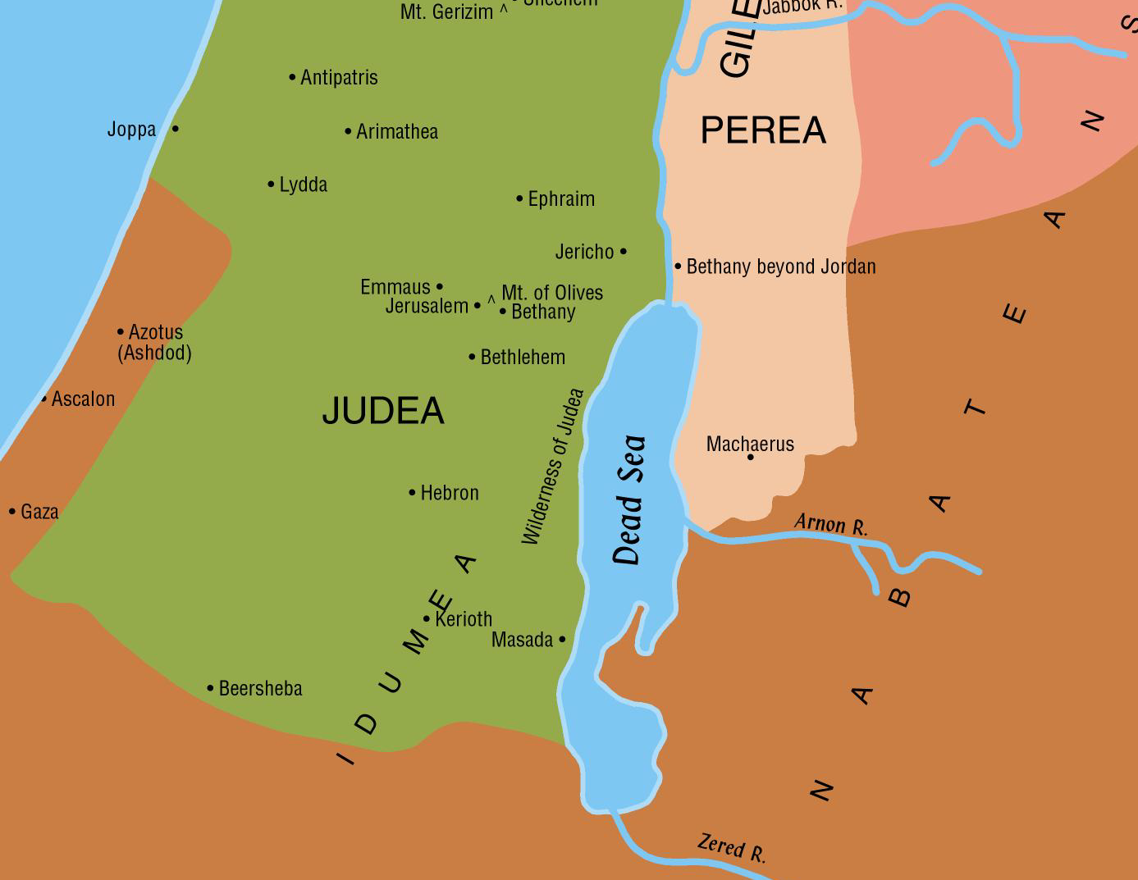
Passing through Samaria and Galilee (Luke17:11)
If our chronology is correct, Jesus passed northward from Ephraim about forty miles, crossing Samaria (here mentioned first), and coming to the border of Galilee. He then turned eastward along that border down the wadi Bethshean which separates the two provinces, and crossed the Jordan into Peræa, where we soon find Him moving on toward Jericho in the midst of the caravan of pilgrims on the way to the Passover.

Slide 4
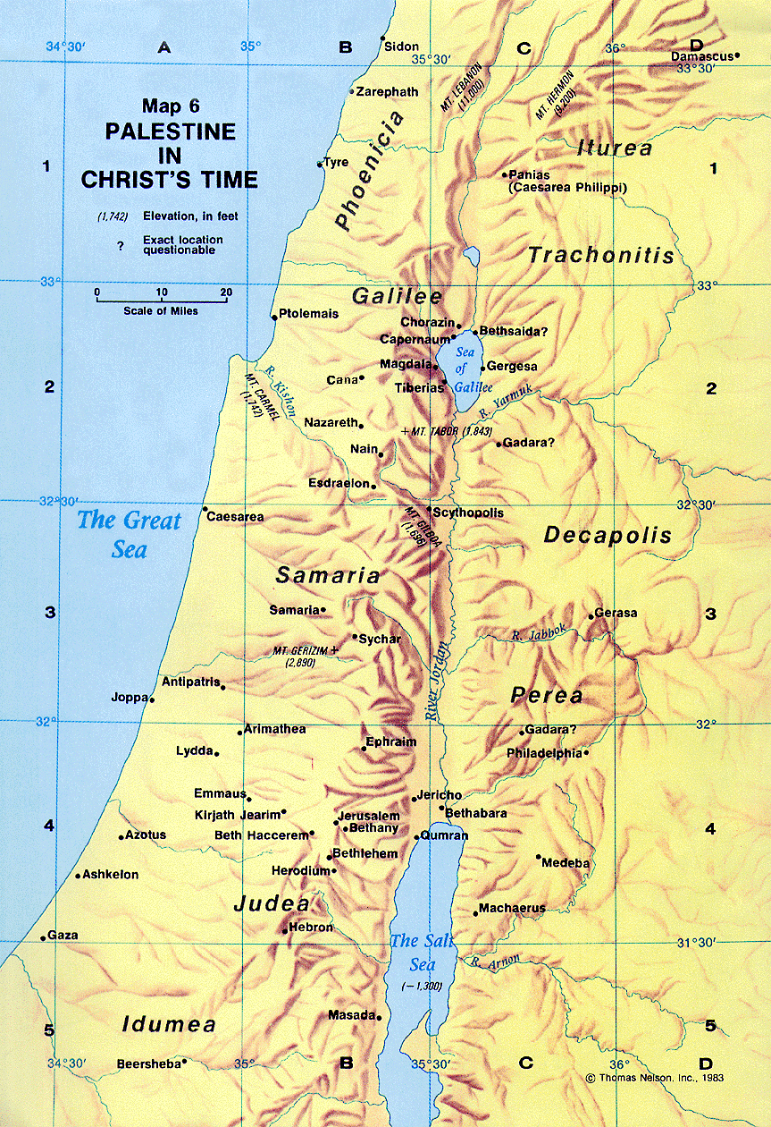
Passing through Samaria and Galilee (Luke17:11)

Slide 5
Passing through Samaria and Galilee (Luke17:11)
Luke 17:12-13, “And as he entered into a certain village, there met him ten men that were lepers, who stood afar off: and they lifted up their voices, saying, Jesus, Master, Have mercy on us.”
Unnamed village.
Lepers stood afar off. (Numbers 15:2; see also Leviticus 13).
“Master, Have mercy on us.”

Slide 6
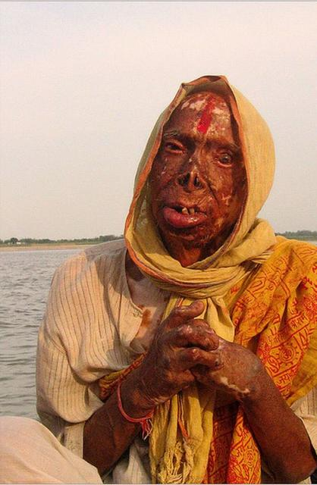
Passing through Samaria and Galilee (Luke17:12-13)
Elisha’s day: Four lepers spoke to one another at the gate of Samaria and went out together to the camp of the Syrian army (2 Kings 7:1-4).
See Luke 5:12-16 for further details on the leper’s physical condition.
These lepers were not allowed to be in close contact with Jesus or His disciples.

Slide 7
Passing through Samaria and Galilee (Luke17:12-13)
“Master, Have mercy on us.” Luke 17:13
Indicates prior knowledge.
After preaching the Sermon on the Mount, another leper had been cleansed by Jesus. Matthew 8:1-4
Note the appeals:
Of blind Bartimaeus. Mark 10:47
The two blind men. Matthew 9:27
Two other blind men at Jericho. Matthew 20:30-31
The woman of Canaan. Matthew 15:22
The father of an epileptic son. Matthew 17:15
The man blind from birth. John 9:1

Slide 8
Passing through Samaria and Galilee (Luke17:11)
Luke 17:14, “And when he saw them, he said unto them, Go and show yourselves unto the priests. And it came to pass, as they went, they were cleansed.”
Show yourselves to the priests. Leviticus 13:2; 14:2; cf. Luke 5:14
Note:
We do not know if they hesitated but we do know that they all went.
We do not know if Jesus touched them as He had done with other lepers. (Luke 5:12- 13)
We do not know how much time transpired or how far they walked before they discovered that they were healed.

Slide 9
Naaman The Leper
2 Kings 5:1-14

Slide 10
Naaman The Leper 2 Kings 5:1-14
Naaman
People Today
Leper verse 1 | Needed help | Sinners Romans 3:23; 6:23; Isaiah 59:1-2

Slide 11
Naaman The Leper 2 Kings 5:1-14
Naaman
People Today
Went to the king verse 6 | Went to the wrong one | Go to a priest, a preacher, a parent. John 14:6; Matthew 17:1-5

Slide 12
Naaman The Leper 2 Kings 5:1-14
Naaman
People Today
Wash in the Jordan verse 10 | Cleansing was conditional | Must obey God Hebrews 5:9; Matthew 7:21

Slide 13
Naaman The Leper 2 Kings 5:1-14
Naaman
People Today
Naaman was wroth verse 11 | Became angry | Unwilling to accept: Baptism Acts 22:16, One church Ephesians 4:4
Notes:
2 Kings 5:11
[Behold, I thought] God's ways are not as our ways (Isa. 55:8-9); he appoints that mode of cure which he knows to be best. Naaman expected to be treated with great ceremony; and instead of humbling himself before the Lord's prophet, he expected the prophet of the Lord to humble himself before him! Behold, I thought;-and what did he think? Hear his words, for they are all very emphatic:
1. "I thought, He will surely come OUT to ME. He will never make his servant the medium of communication between ME and himself.
2. And stand-present himself before me, and stand as a servant to hear the orders of his God.
3. And call upon the name of Yahweh HIS God; so that both his God and himself shall appear to do me service and honour.
4. And strike his hand over the place; for can it be supposed that any healing virtue can be conveyed without contact?
Had he done these things, then the leper might have been recovered."
(from Adam Clarke's Commentary, Electronic Database. Copyright (c) 1996 by Biblesoft)

Slide 14
Naaman The Leper 2 Kings 5:1-14
Naaman
People Today
“I thought” verse 11 | Wanted his way | “Faith only” James 2:24; “church of your choice” Ephesians 5:23; “Do nothing” 1 Corinthians 15:58

Slide 15
Naaman The Leper 2 Kings 5:1-14
Naaman
People Today
Abana and Pharpar verse 12 | Wanted to substitute | Human creeds for the Bible 2 Timothy 3:16-17; Denominations for the church Matthew 5:13

Slide 16
Naaman The Leper 2 Kings 5:1-14
Naaman
People Today
Dipped 7 times, clean verse 14 | Blessed at obedience | Matthew 7:24; Hear – Romans 10:17; Believe – John 8:24; Repent – Luke 13:3; Be Baptized – Mark 16:16 Faithfulness – Revelation 2:10
These ten lepers were not cleansed until they obeyed Jesus and went.

Slide 17
Passing through Samaria and Galilee (Luke17:15-19)
Luke 17:15-19, “And one of them, when he saw that he was healed, turned back, with a loud voice glorifying God; and he fell upon his face at his feet, giving him thanks: and he was a Samaritan. And Jesus answering said, Were not the ten cleansed? but where are the nine? Were there none found that returned to give glory to God, save this stranger?”
Apparently nine of the lepers were Jews.
Note: On his way to the priests at Mount Gerizim the Samaritan turned back to express his thanks. This Samaritan was more spiritual than any of his Jewish companions.
A Samaritan was among them because they were along the border of his country, and because the fellowship of affliction and disease obliterated the distinctions of race, as it does to this day.

Slide 18
Passing through Samaria and Galilee (Luke17:15-19)
Luke 17:15-19, “And one of them, when he saw that he was healed, turned back, with a loud voice glorifying God; and he fell upon his face at his feet, giving him thanks: and he was a Samaritan.”
The beginning of the Samaritans. 2 Kings 17.
The Samaritans were also a continuous source of difficulty to the Jews who rebuilt Jerusalem after returning from Babylonian captivity (Ezra 4, especially verses 2-5; Nehemiah 4, especially verse 2).
The Samaritan woman. John 4
Traveling through Samaria. Luke 9:52-55

